Slide 1
Documentation Slides
MUSC + BF Navitoclax Study

Slide 2
Data Summary
Tumor Origin
Genetic Features
Type | COSMIC | CTD
Blood | 58 | 143
Lung | 87 | 127
Breast | 34 | 36
CNS | 27 | 42
Skin | 30 | 50
Other | 174 | 359
Total | 410 | 757
Type | COSMIC | CTD
Gene Expression | 16,062 | 16,062
CNV | 20,416 | 20,416
SNP (>=3 cases) | 311 | 857
Total | 36,789 | 37,335
Navitoclax Sensitivity
Response | COSMIC | CTD
Sensitive | 78 (19%) | 117 (15.5%)
Not Sensitive | 332 (81%) | 640 (84.5%)
Total | 410 | 757

Slide 3
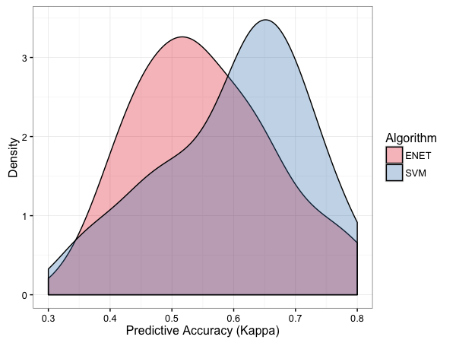
Training Process
Raw Data
Level 1 Resampling
(3x 10-fold CV)
Level 1 Resampling
(3x 10-fold CV)
…
Feature Selection + Preprocessing (Fold 1)
Feature Selection / Preprocessing (Fold 30)
Level 2 Resampling
(5-fold CV)
Level 2 Resampling
(5-fold CV)
Error Distribution Built for
Models Across Resamples
…
Parameter
Optimization (Fold 1)
Parameter
Optimization (Fold 5)
Parameter Selection + Retraining
Prediction Error Estimation

Slide 4
ML Models Applied
Elastic Net Regression (with and without sample weighting)
SVM (Radial Kernel)
kNN
Random Forest
GBM
Partial Least Squares
Multivariate Adaptive Regression Splines (MARS)
eXtreme Gradient Boosting
Shrinkage Discriminant Analysis (LDA with James-Stein type shrinkage) (R package)
Shrunken Centroids Regularized Discriminant Analysis (R package)
Predictive Analysis for Microarrays
Ensemble Models
Averaging Model – includes RF, SVM, Elastic Net,
GLM Model – Stacked ensemble of same as above, with GLM as stacking learner

Slide 5
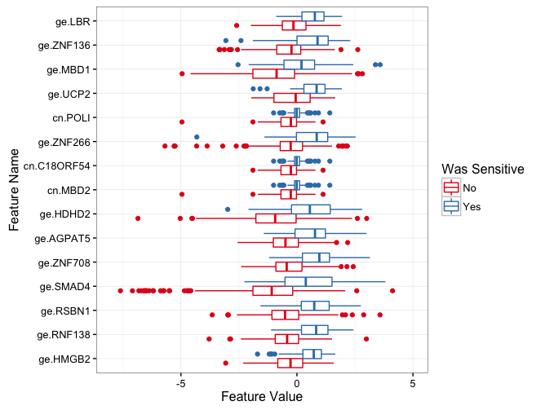
Top Features
Frequency of Feature
Selections (in resampling)
Feature Values by Navitoclax Sensitivity
Feature | Frequency
ge.HMGB2 | 30
ge.RNF138 | 30
ge.RSBN1 | 30
ge.SMAD4 | 30
ge.ZNF708 | 30
ge.AGPAT5 | 28
ge.HDHD2 | 28
cn.MBD2 | 27
cn.C18ORF54 | 26
ge.ZNF266 | 26
cn.POLI | 25
ge.UCP2 | 22
ge.MBD1 | 21
ge.ZNF136 | 21
ge.LBR | 18
cn.WDR7 | 14
ge.ABHD18 | 13
ge.CXXC1 | 12
ge.ZNF292 | 12
ge.ME2 | 11
ge.CXCR4 | 10

Slide 6
Kappa vs #Features (COSMIC)

Slide 7
Accuracy vs #Features (COSMIC)

Slide 8
Kappa vs #Features (CTD)

Slide 9
Accuracy vs #Features (CTD)

Slide 10
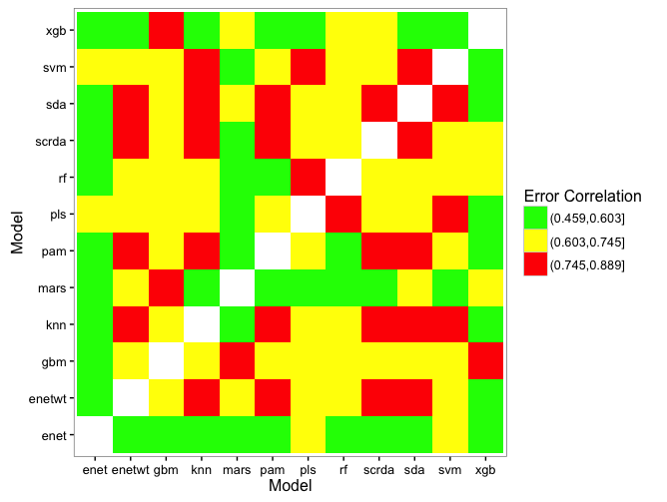
Ensemble Selection
Kappa Correlation Between Models
(across 30 folds)
SVM, SCRDA, and RF chosen due to relatively high performance and mid-range correlation in those same measurements

Slide 11
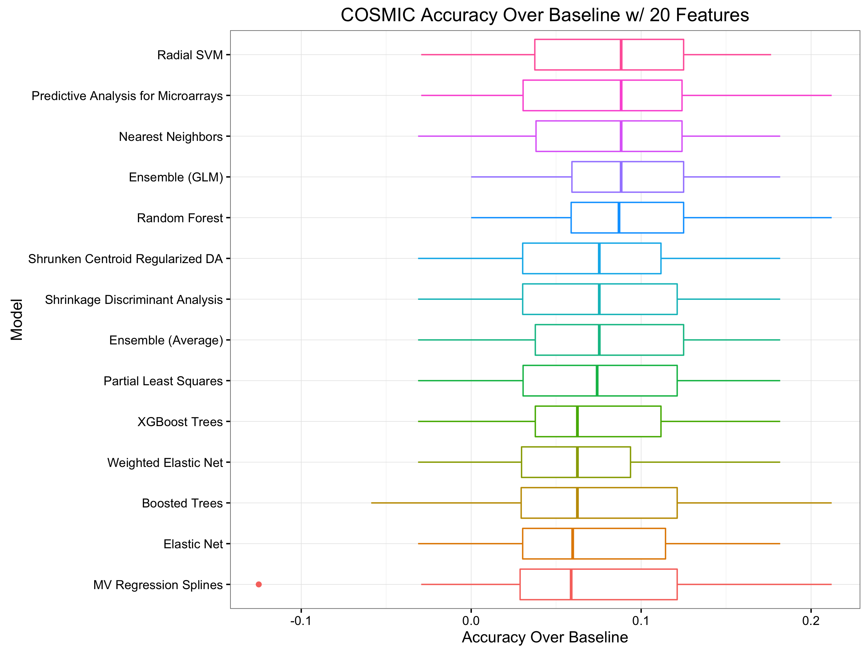
Model Accuracy (COSMIC)

Slide 12
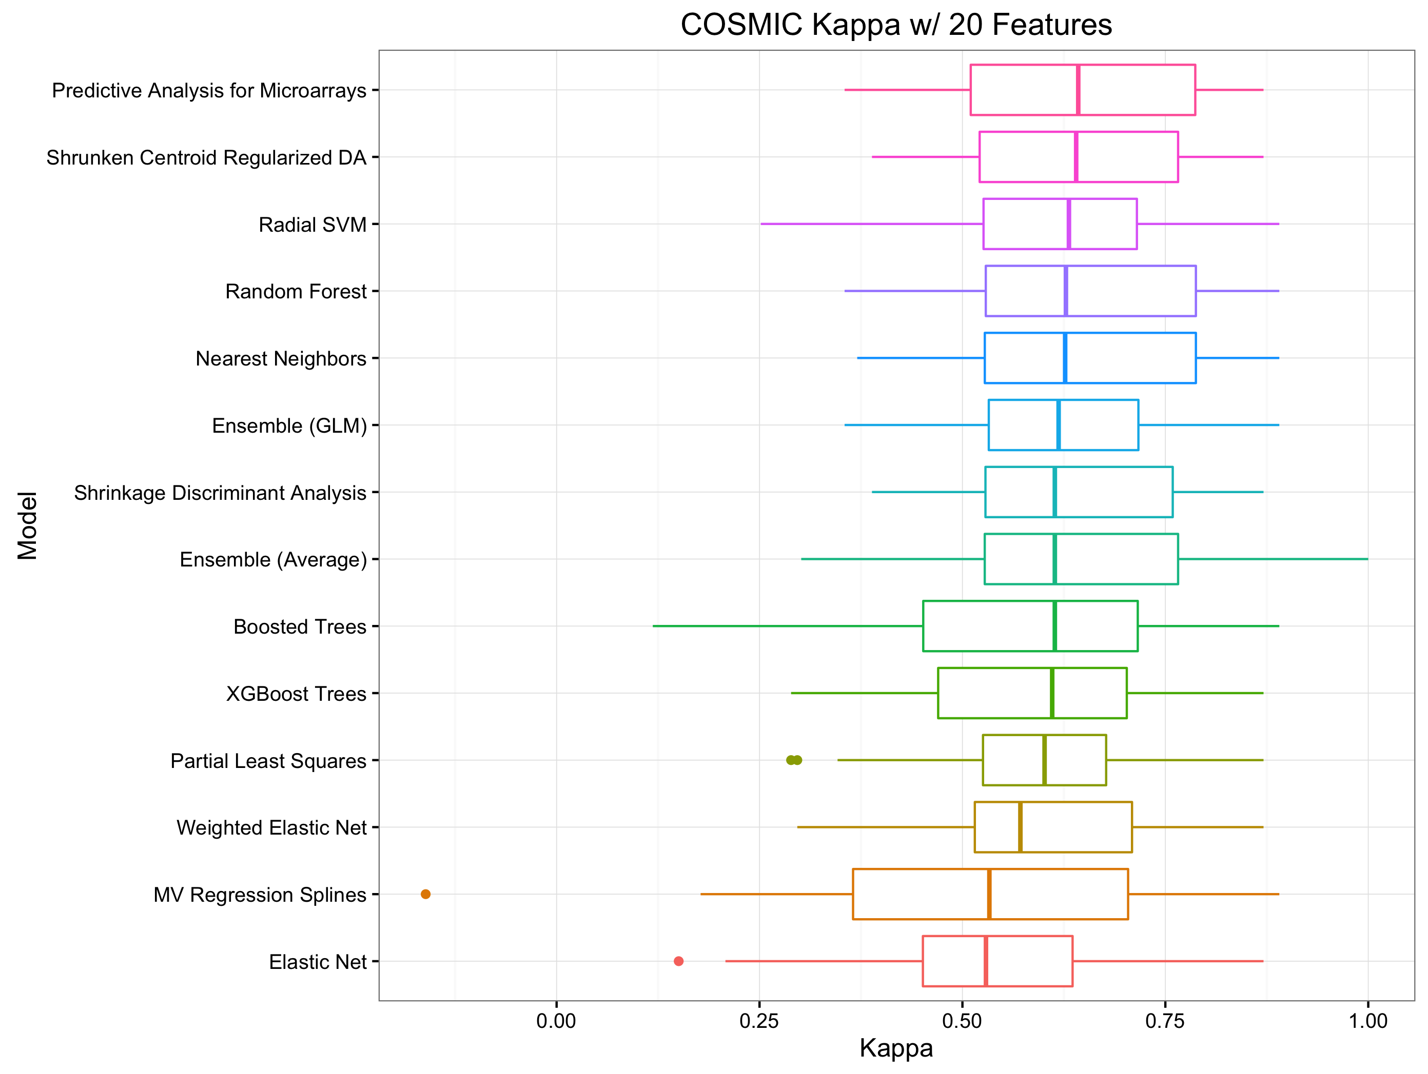
Model Kappa (COSMIC)

Slide 13
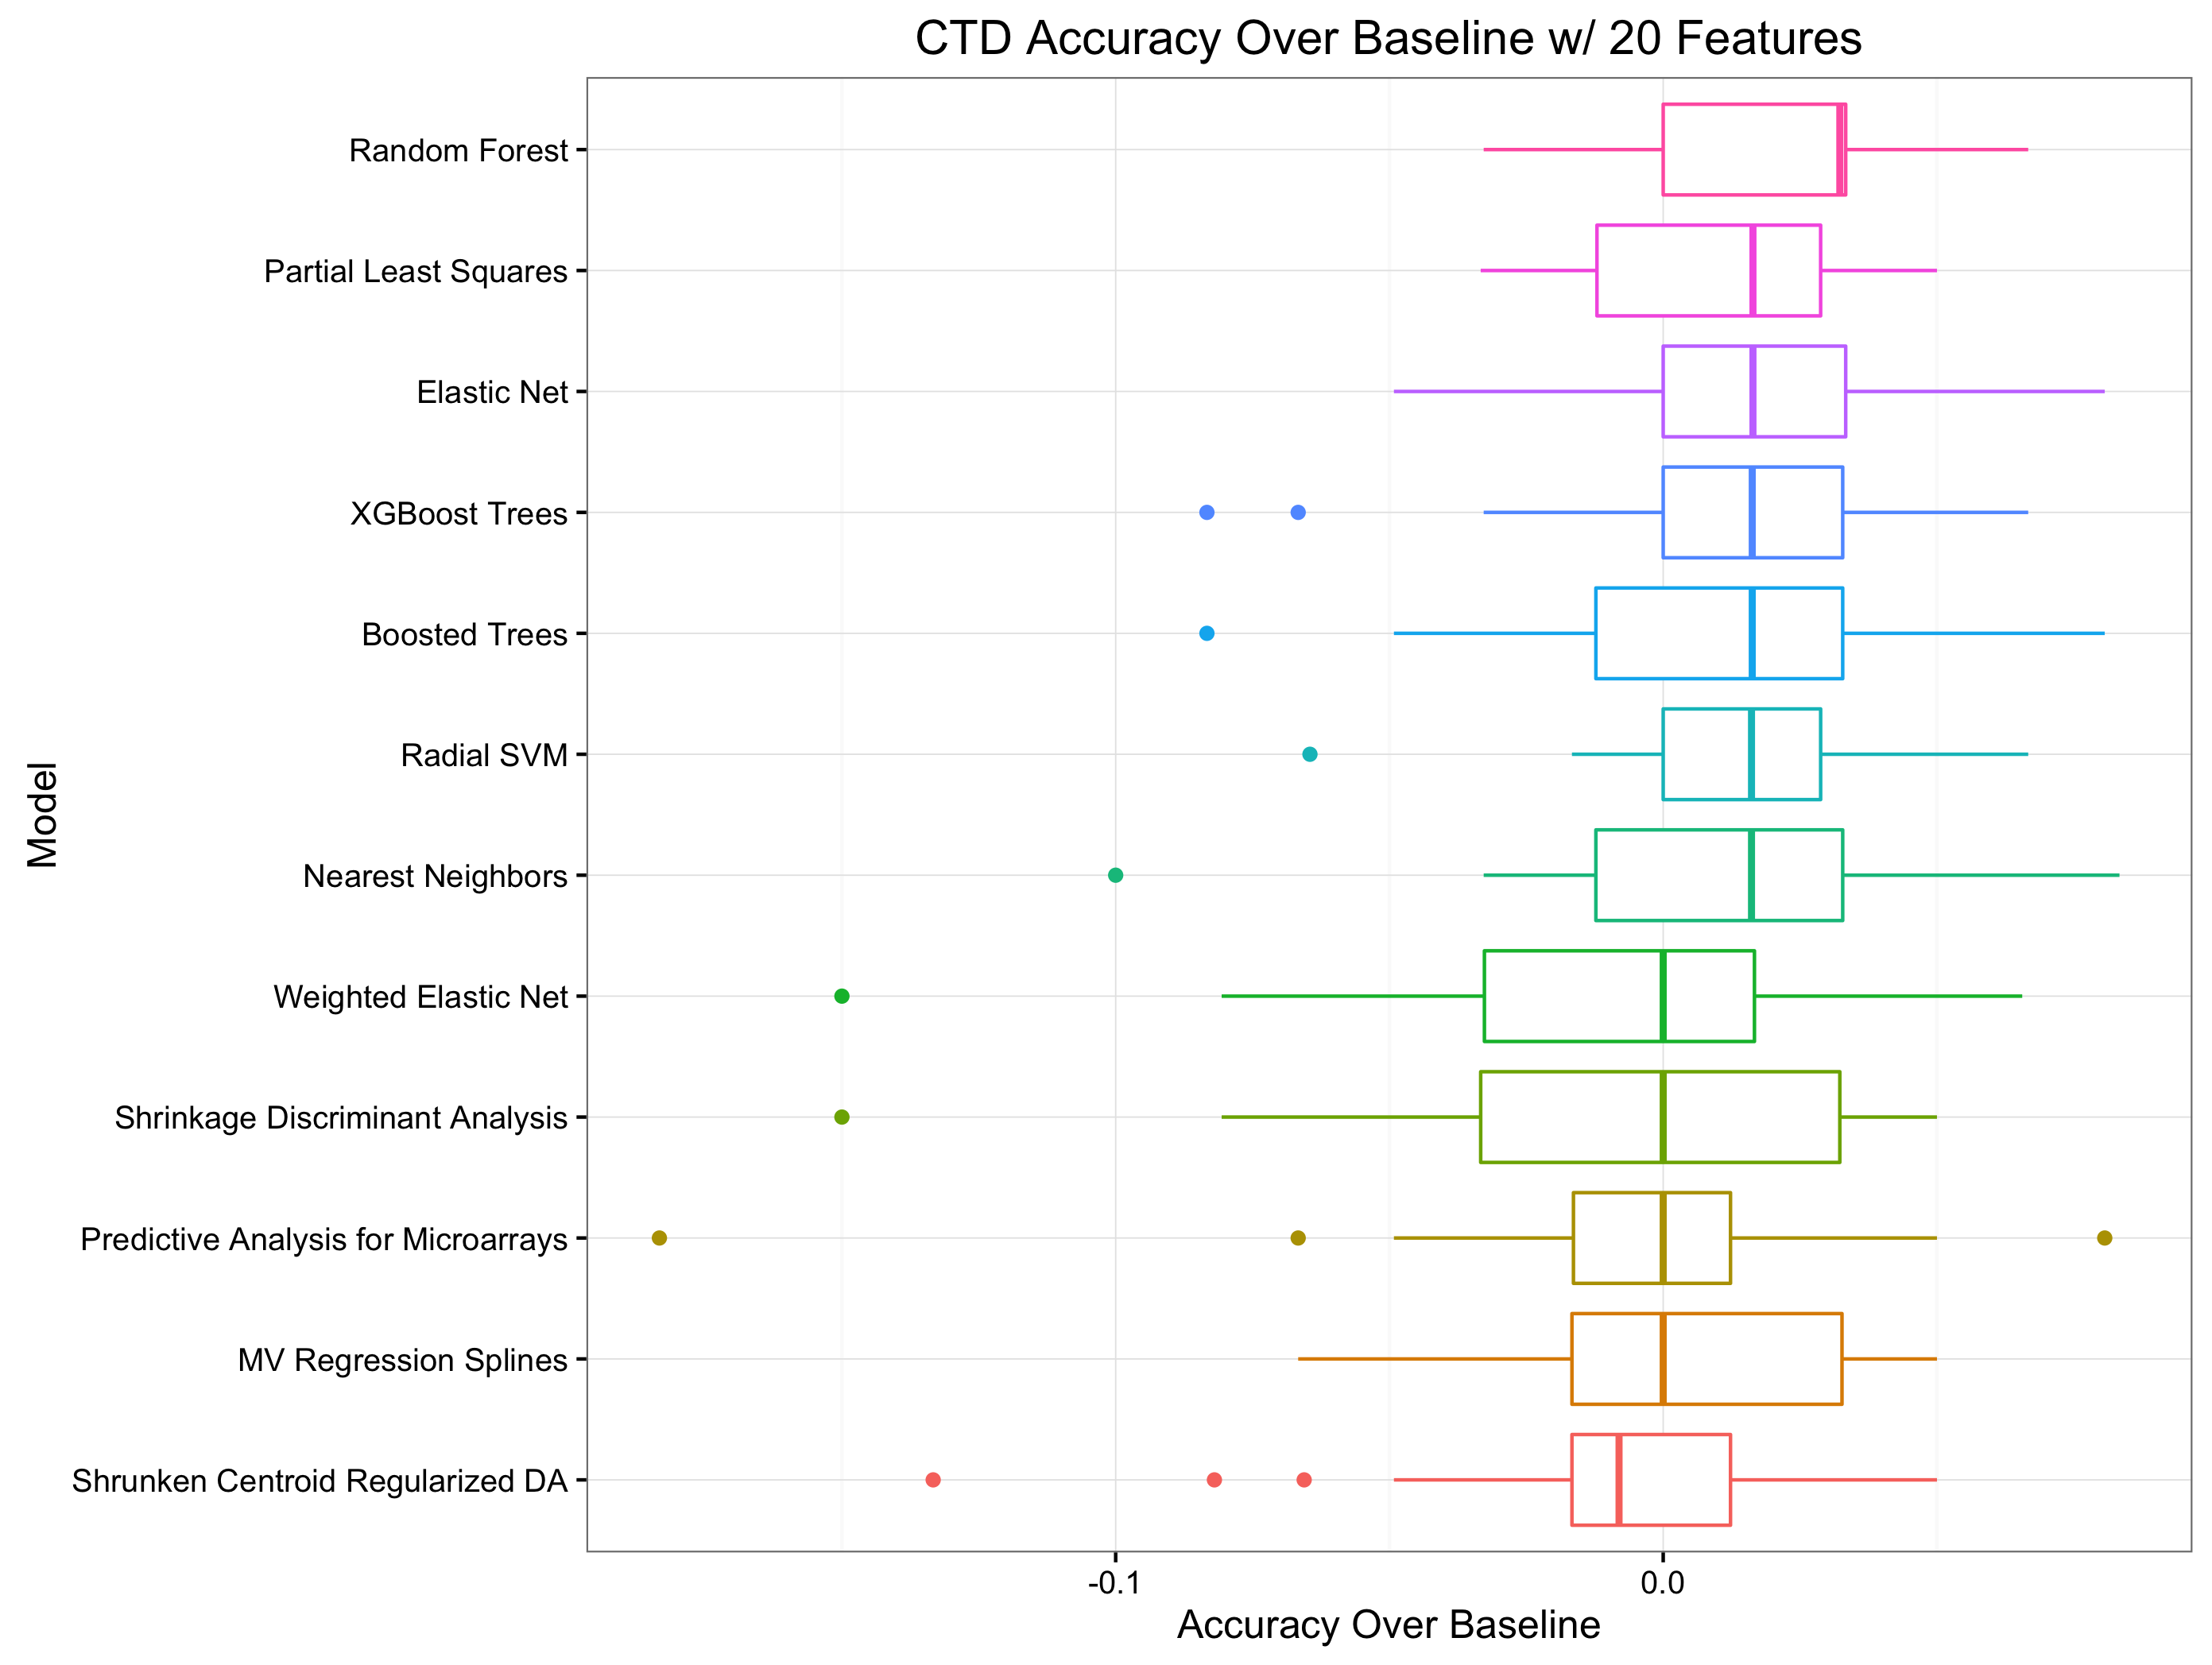
Model Accuracy (CTD)

Slide 14
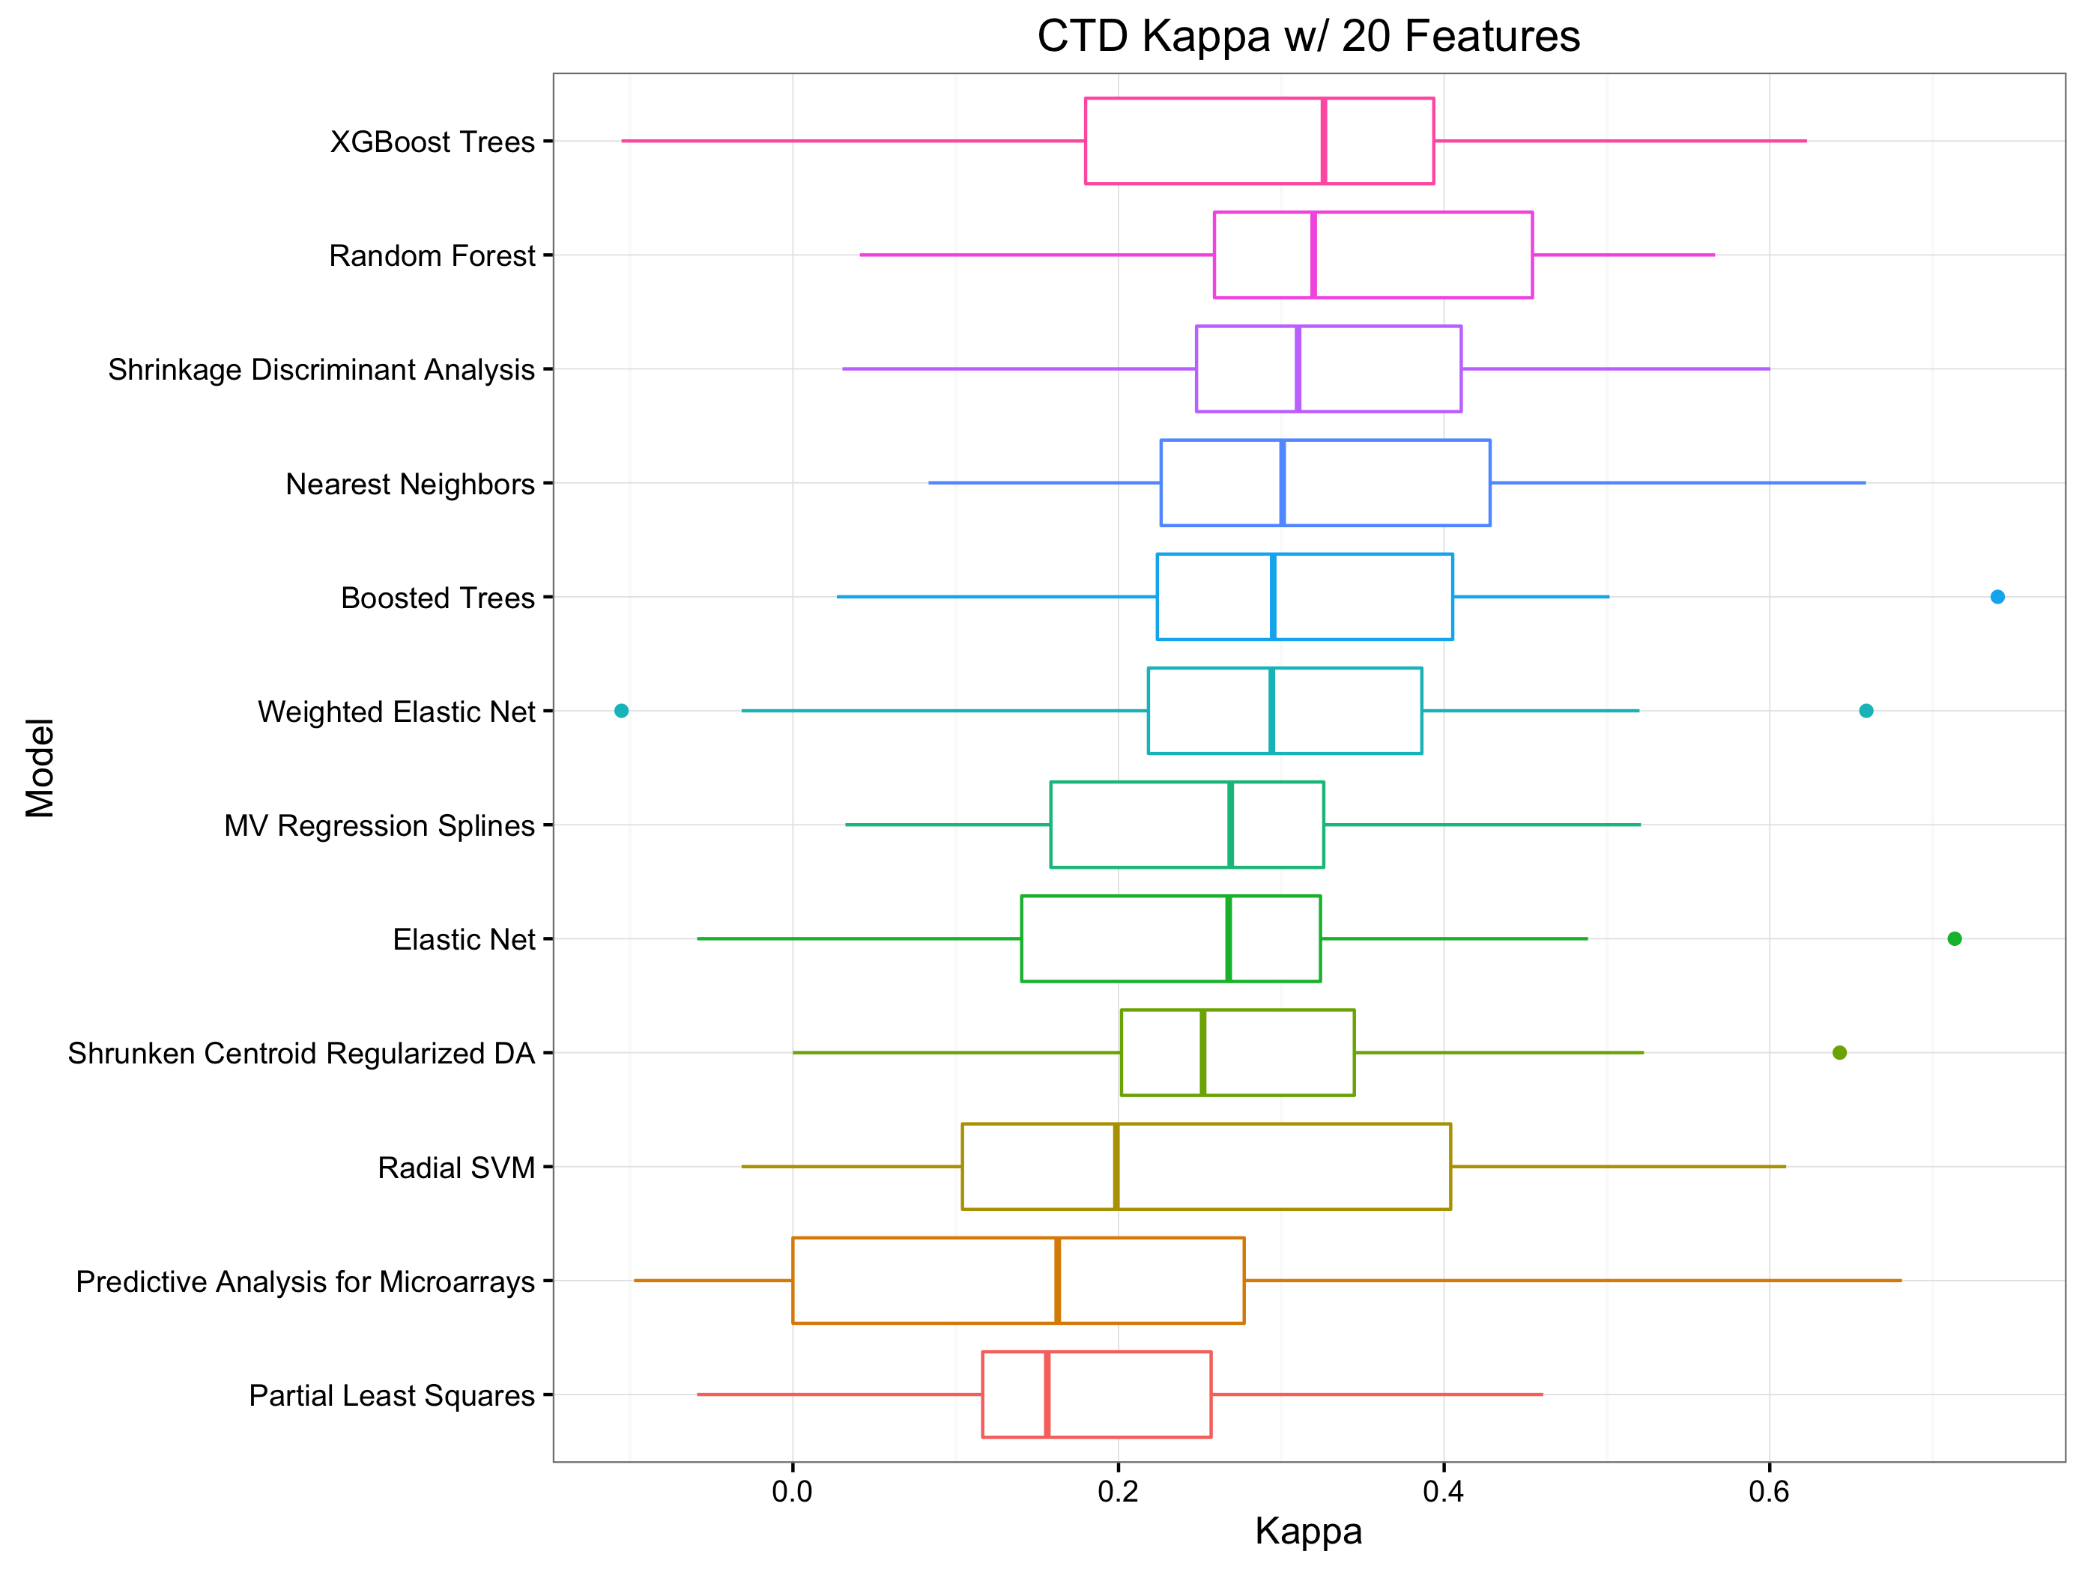
Model Kappa (CTD)

Slide 15
Accuracy In Practice (Precursor)
All results so far have been shown with respect to a “training” dataset chosen as 80% (randomly) of the original dataset for either source (COSMIC or CTD)
To estimate how well the above approaches would extend to a laboratory setting, the following was done:
The glm ensemble model over SCRDA, SVM, and RF predictions was retrained on the entire training dataset (80% of the original)
This ensemble was used to make predictions for the remaining 20% of the data as probabilities of any one sample being sensitive to the Navitoclax treatment
The accuracy of these predictions was summarized as gain and sensitivity charts in the following slides

Slide 16
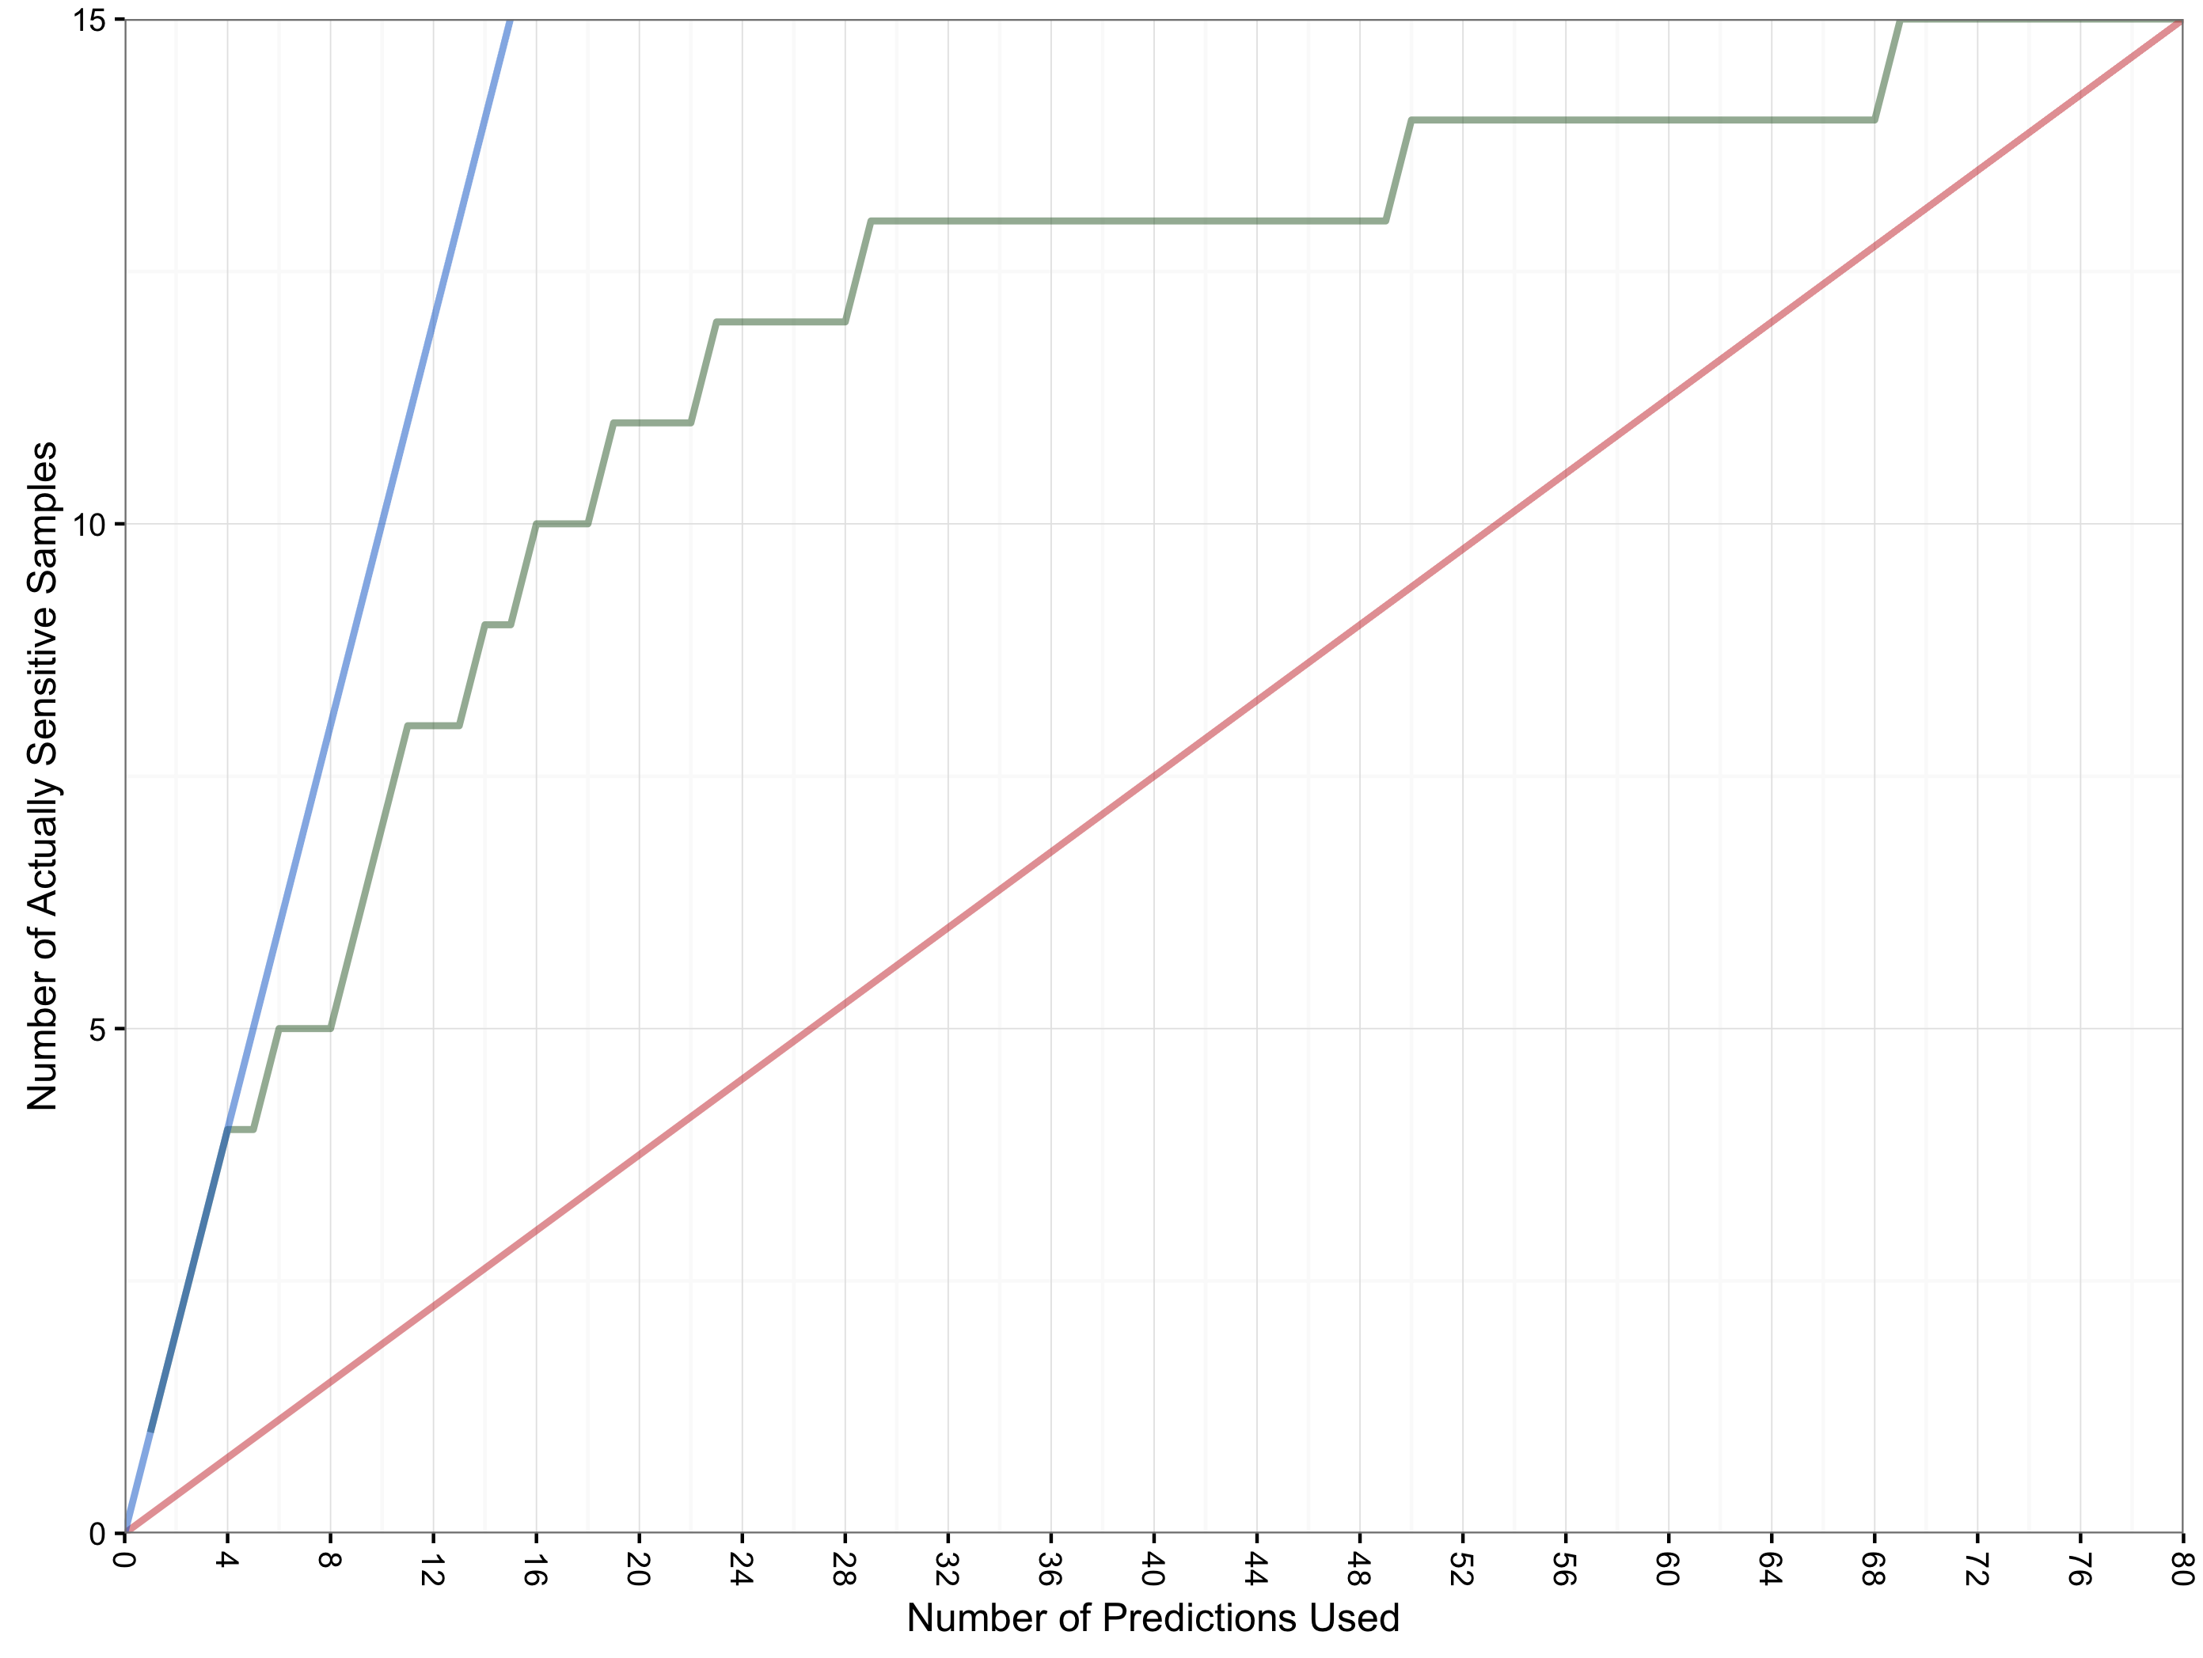
Gain In Practice (COSMIC)
The COSMIC hold out set consisted of 80 samples
Of these 80 samples, 15 were truly “sensitive”
The chart below shows how the number of truly sensitive samples corresponds to samples predicted as sensitive
Perfect Model
Ensemble
Model
8 of the top 11 samples predicted as most likely to be sensitive were truly sensitive
Random Model
Predictions of highest probability are used first

Slide 17
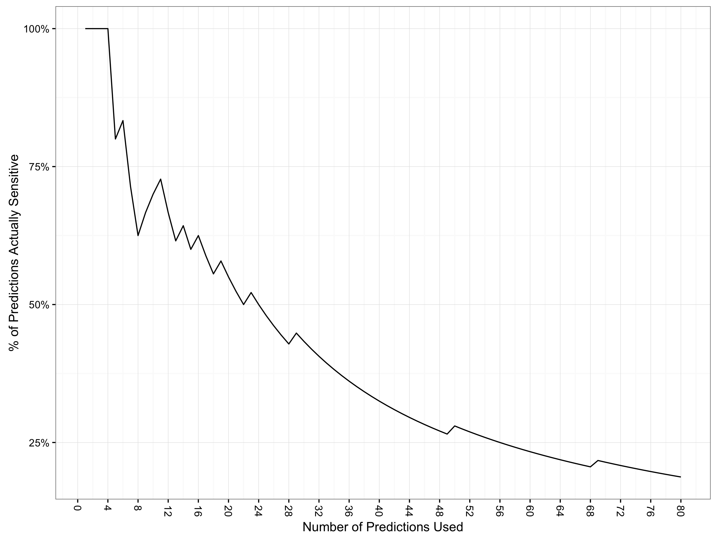
Accuracy In Practice (COSMIC)
The COSMIC hold out set consisted of 80 samples
Of these 80 samples, 15 were truly “sensitive”
The chart below shows how the percentage of truly sensitive samples corresponds to samples predicted as sensitive
At 22 predictions of 80 considered (27.5% of samples), accuracy falls to 50%
Predictions of highest probability are used first

Slide 18
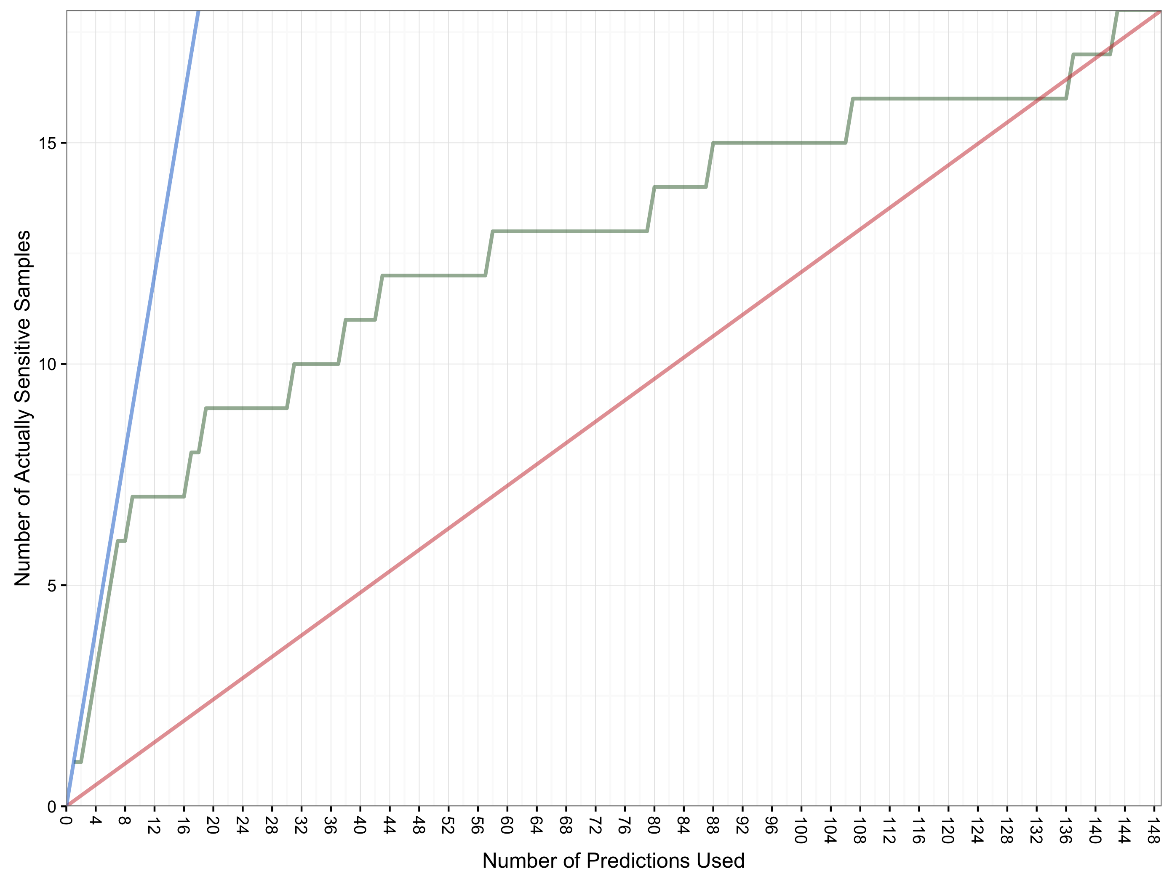
Gain In Practice (CTD)
The CTD hold out set consisted of 149 samples
Of these 149 samples, 18 were truly “sensitive”
The chart below shows how the number of truly sensitive samples corresponds to samples predicted as sensitive
Ensemble
Model
Perfect Model
7 of the top 9 predictions are correct but after that performance degrades to that of a random model (or worse)
Random Model
Predictions of highest probability are used first

Slide 19
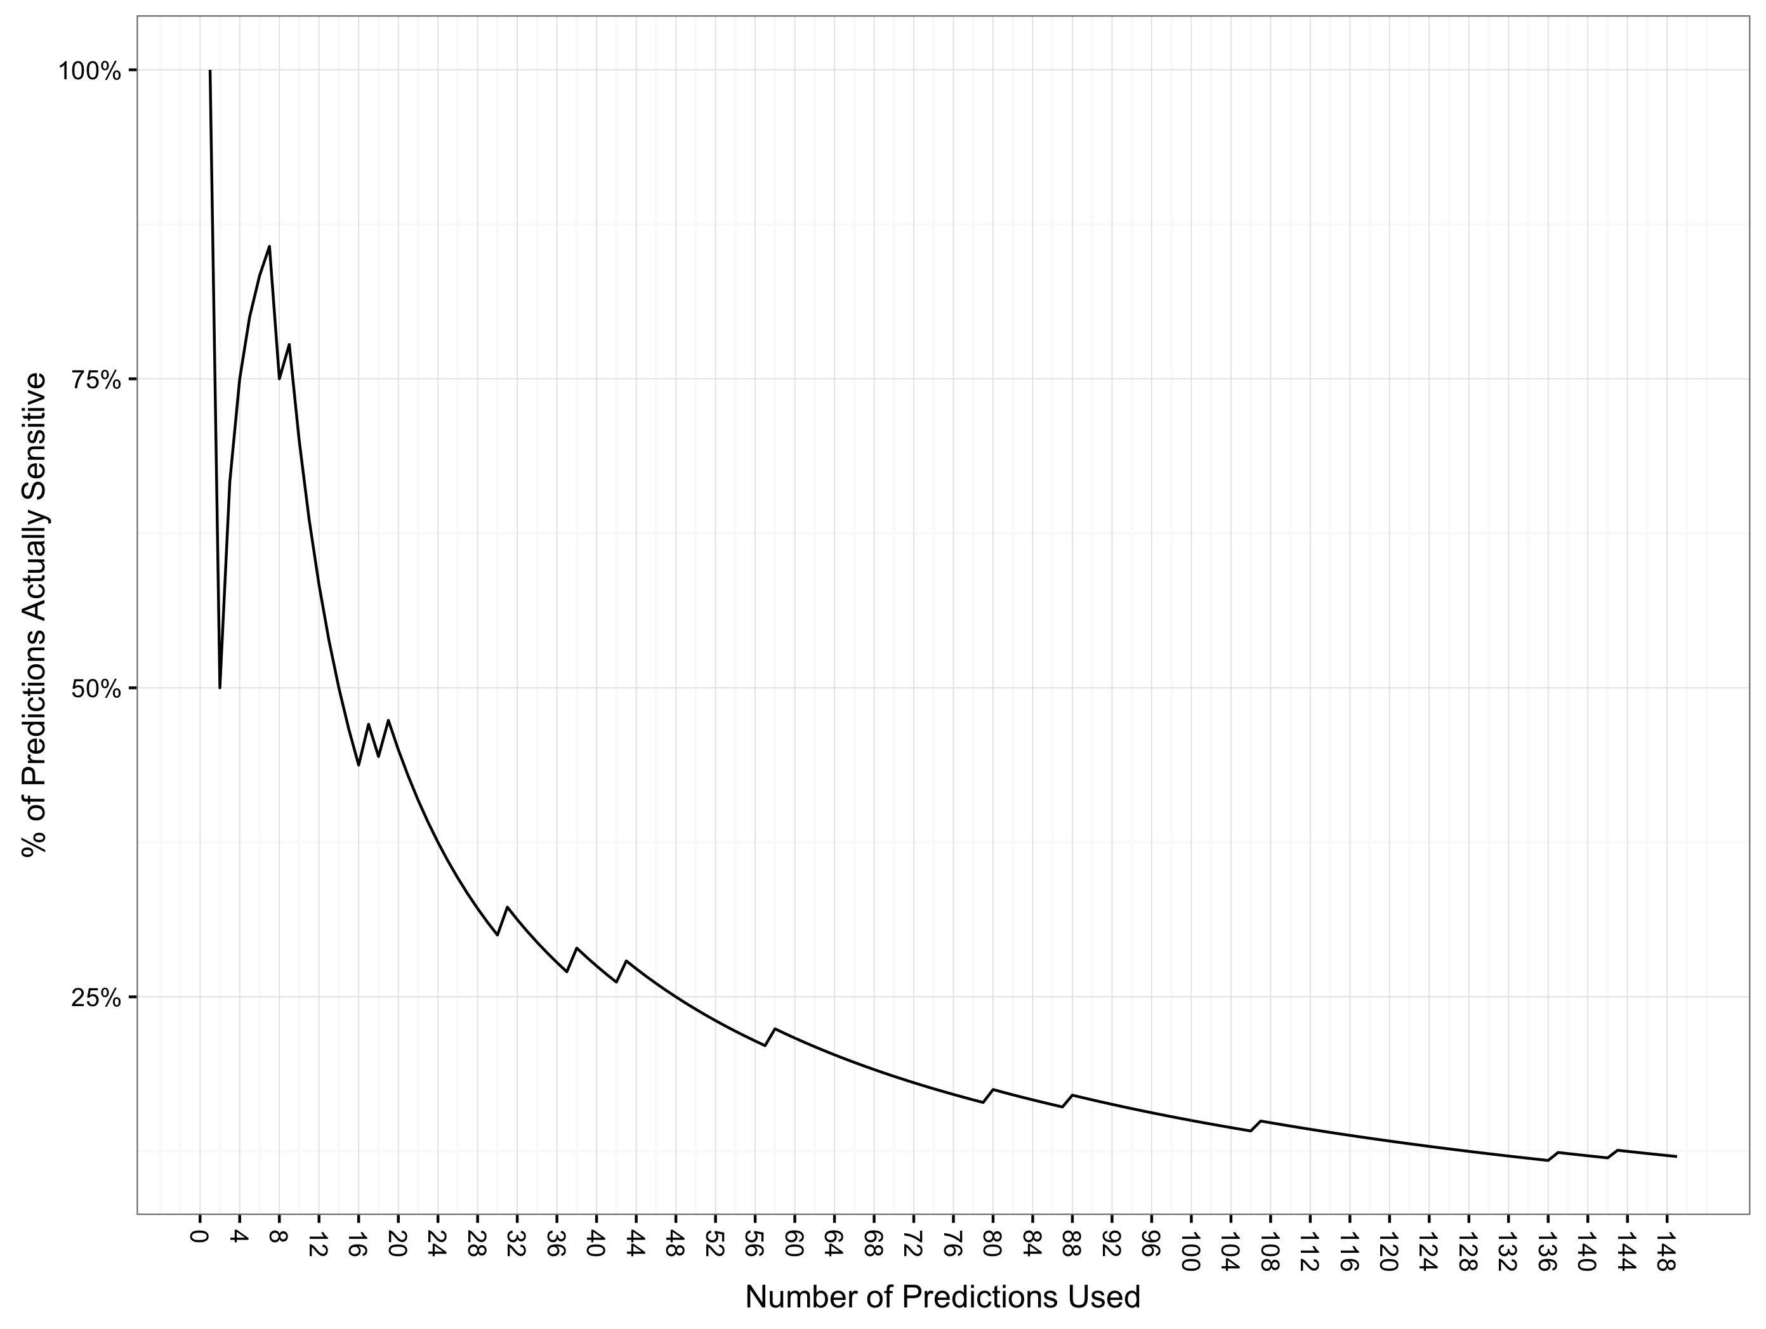
Accuracy In Practice (CTD)
The CTD hold out set consisted of 149 samples
Of these 149 samples, 18 were truly “sensitive”
The chart below shows how the percentage of truly sensitive samples corresponds to samples predicted as sensitive
At 14 predictions of 149 considered (9.3% of samples), accuracy falls to 50%
Predictions of highest probability are used first

